Slide 1







Software Engineering
Lecture One
2026
Najwan abed

Slide 2
Software Engineering syllabus
The ‘software Crisis’
What is software
Software Characteristics
Software Applications
Definitions of software engineering
Software engineering layers
The software process
Software process models
The linear sequential model
The prototyping model
The rad model
Evolutionary software process models
The management spectrum
Testing
Control graph

Slide 3

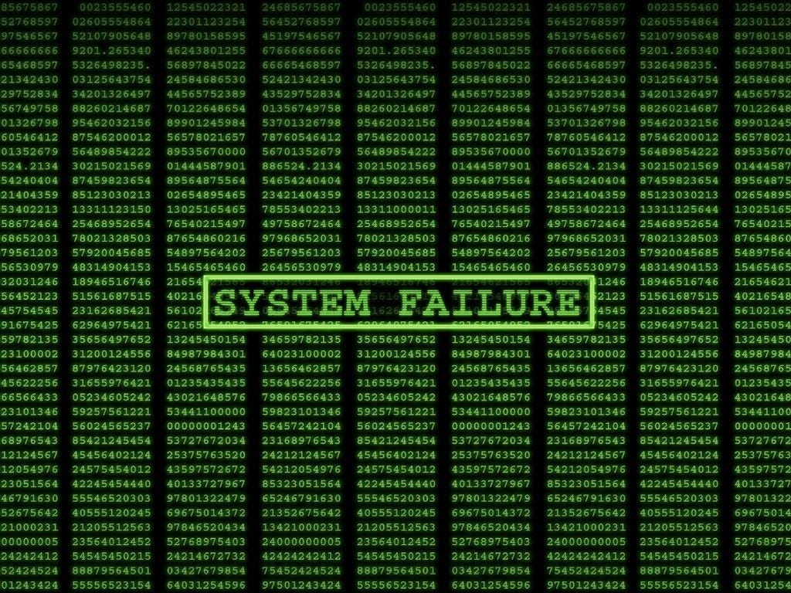


The Software Crisis
Software lags far behind the hardware's potential!
Many large projects fail in that they're late, over budget, don't work well, or are abandoned

Slide 4







How Crisis Manifested
Over-budget
Over-time
Projects running over-budget
Projects running over-time
Inefficient
Low Quality
Software was very inefficient
Software was of low quality
Unmet Requirements
Unmanageable
Software often did not meet requirements
Projects were unmanageable and code difficult to maintain

Slide 5










Famous Software Failures
Therac 25
Y2K Bug
Radiation therapy machine failure
Millennium date rollover issue
Cost lives
Expensive scare
Pentium FDIV Bug
Floating point division error
Arianne 5
Expensive scare
Self-destructed 37 seconds after launch
$370 million losses
London Ambulance Service (LAS) 1992
Thoroughly documented project failure

Slide 6









London Ambulance Service 1992
Paper Tickets
Street Atlas
Details written on paper tickets for each call
Map reference lookup in street atlas
2,000-3,000
Calls per day
Conveyor Belt
Central Point
Tickets passed to central point
Controller de-duplicates tickets
~66%
Emergency (999) calls
Average Response Time
3 min
From call to dispatch
200
Staff (of 2,700 total)

Slide 7
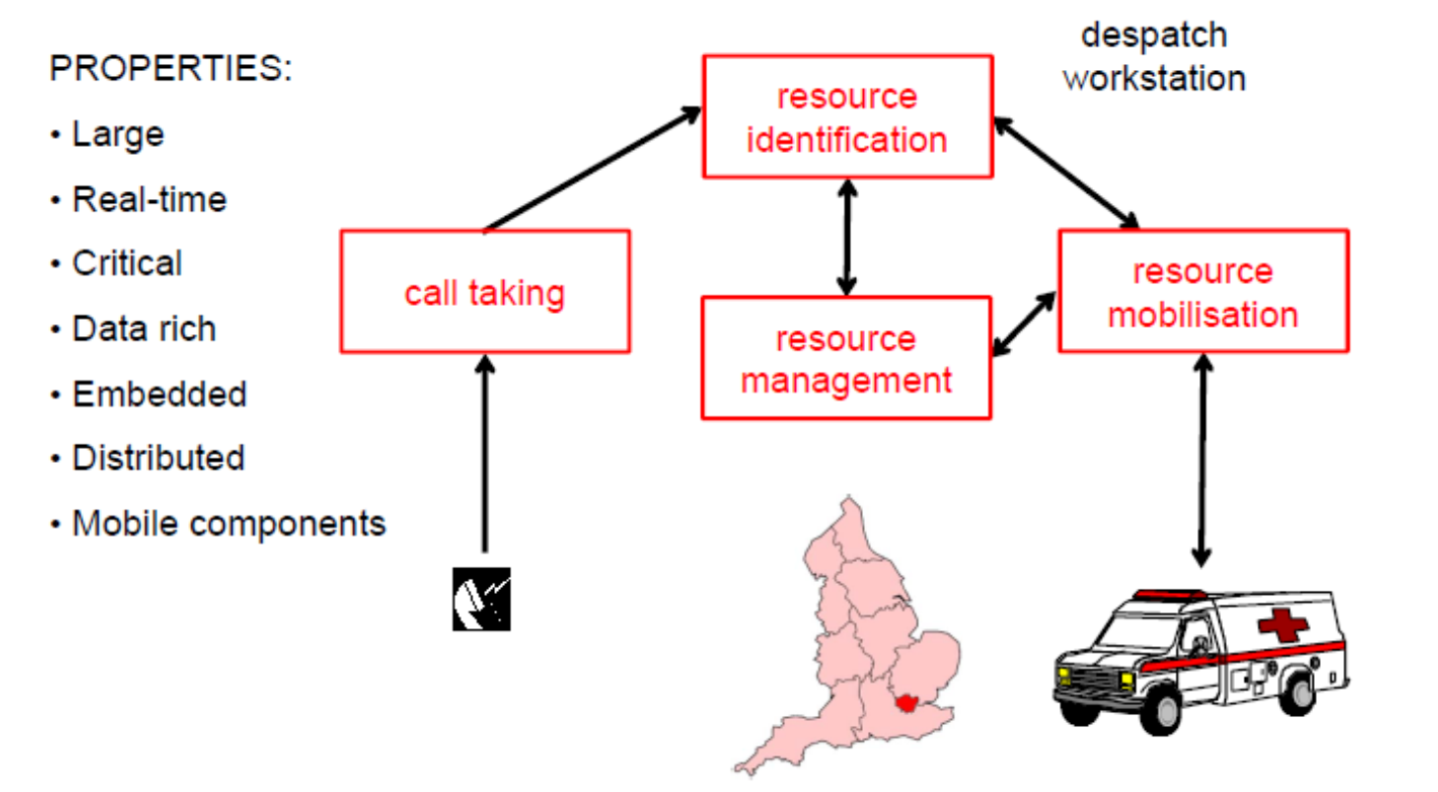
The manual dispatch system

Slide 8
The manual implementation

Slide 9








Automation Attempt
1980s Failure
Awarded To
Timeline Issue
Automation attempt failed load test
Systems Options Ltd
Most firms said timeline was unrealistic
Consortium with Apricot & Datatrak
Tender Process
Market Interest
Contract Price
Feb 1991: Tender sent
35
19
£937K
Jan 1992: Deadline
Firms Looked
Proposed
£700K cheaper than next bidder

Slide 10







Project Failures
Ignored Advice
No Systems View
On cost and timescale
Lack of holistic approach
"They made virtually every mistake in the book"
Inflexible Spec
Ignored Practices
Incomplete specification
Established work practices
Paul Williams
LAS Inquiry Member
Unrealistic Timeline
Technical Fix
Common mistakes in software project failures
Timescale was unrealistic
Change through technical system

Slide 11











Understanding Software
Software Characteristics
Software Applications
Intangible
System Software
Application Software
Not physical, exists in digital form
Operating systems, utilities
Business, productivity tools
Logic-Based
Engineering Software
Embedded Software
Comprises algorithms and data structures
CAD/CAM, simulation tools
Real-time control systems
Developed Not Manufactured
AI Software
Web-Based Software
Created by engineers, not mass-produced
Machine learning, neural networks
Cloud services, web apps

Slide 12






Software Engineering
Software Engineering Layers
Quality Layer
QA focus, testing, verification
Definition
Tools Layer
Automated support, CASE tools
The application of engineering principles to software development
Methods Layer
How to do it better, techniques
Process Layer
How to do it, workflow models

Slide 13
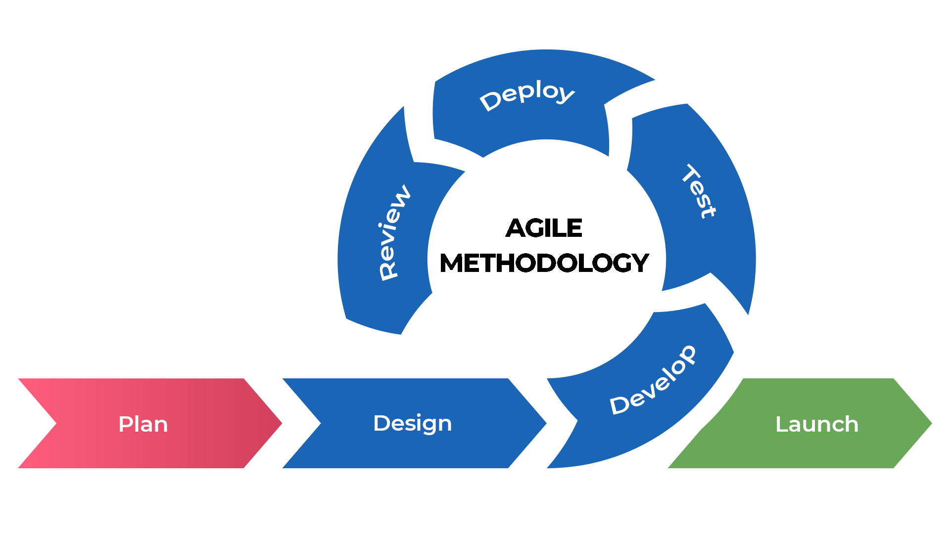





Software Process Models
Linear Sequential Model
Waterfall approach, sequential phases
Prototyping Model
Rapid iteration, user feedback loop
RAD Model
Rapid Application Development
Evolutionary Models
Incremental, spiral approaches

Slide 14






The Management Spectrum
Process Management
People Management
Testing
Ensuring software meets quality standards and requirements
Planning, scheduling, tracking
Team coordination, motivation
Unit Testing
Technology Management
Quality Management
Integration Testing
System Testing
Methods, tools, automation
Testing, QA, standards
Acceptance Testing

Slide 15



References & Further Reading
Primary Textbook
Software Engineering Ninth Edition
by Ian Sommerville
Key Topics Covered
Software Crisis
Software Characteristics
Process Models
Testing
Control Graph

